Slide 1


Chapter 2
Point-to-Point Protocol
(PPP)
Part I

Slide 2
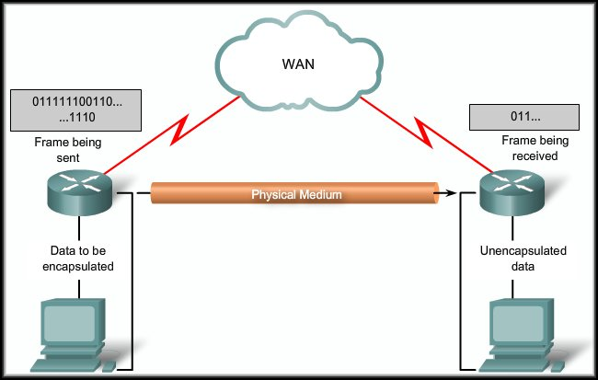
Point-to-Point Protocol (PPP)
Introducing Serial Communications

Slide 3
How Does Serial Communication Work?
Most PCs have both serial and parallel ports.
  Electricity can only move at one speed.
  Data is compressed so that less bits are necessary and then require less time on the wire, or transmit the bits simultaneously.
  Computers make use of relatively short parallel connections between interior components.
  Use a serial bus to convert signals for most external communications.

Slide 4
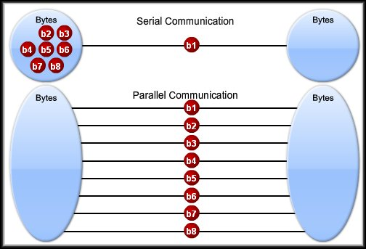
How Does Serial Communication Work?
Serial – one bit at a time
Two wires to send and receive.
Eight wires to send and receive.
Parallel – bits over more wires simultaneously.

Slide 5
How Does Serial Communication Work?
In both cases, the remaining wires are used for control signals.
  The parallel link theoretically transfers data eight times faster than a serial connection.
  In reality, it is often the case that serial links can be clocked considerably faster than parallel links, and they achieve a higher data rate.
  Two factors affect parallel communications:
    Clock Skew.
    Crosstalk Interference.

Slide 6
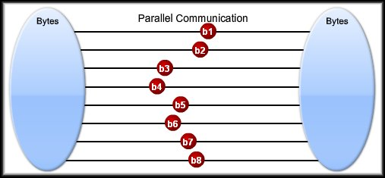
How Does Serial Communication Work?
Parallel Communications Clock Skew:
  In a parallel connection, it is wrong to assume that the 8 bits leaving the sender at the same time arrive at the receiver at the same time.
  In reality, some of the bits get there later than others.
  Not trivial to overcome.
    Read, wait, wait adds time.

Slide 7
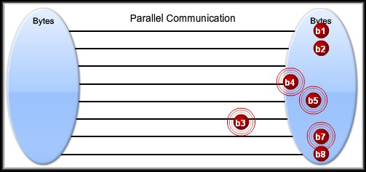
How Does Serial Communication Work?
Parallel Communications Crosstalk Interference:
  In a parallel connection ,the wires are physically bundled in a parallel cable.
  The possibility of crosstalk across the wires requires more processing.

Slide 8
How Does Serial Communication Work?
Serial Communication:
  Clock skew is not a factor because most serial links do not need the same type of parallel clocking.
  Crosstalk Interference is minimized since serial cables have fewer wires and network devices transmit serial communications at higher, more efficient frequencies.
X
X

Slide 9
Serial Communication Standards
Receive:
Same protocol used to
de-capsulate the frame.
Frame transmitted bit by bit on a physical medium to the WAN.
Send:
Data encapsulated using a specific WAN protocol.

Slide 10
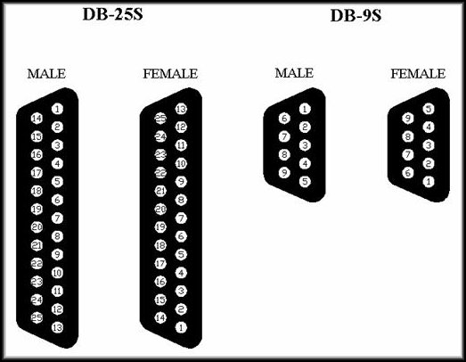
Serial Communication Standards
Three key serial
communication standards:
  RS-232C or
  newer RS-422, RS-423:
    Most serial ports on
    personal computers
    conform to the RS-232C standards.
    Both 9-pin and 25-pin connectors are used.
    A serial port is a general-purpose interface that can be used for almost any type of device, including modems, mice, and printers.

Slide 11
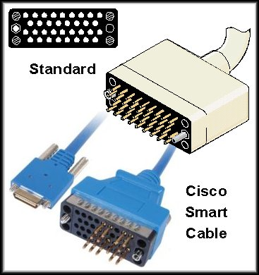
Serial Communication Standards
Three key serial
communication standards:
  V.35:
      V.35 is the interface
      standard used by most
      routers and DSUs that
      connect to T1 carriers.
      V.35 cables are
      high-speed, serial
      assemblies designed to support higher data rates and connectivity between DTEs and DCEs over digital lines.

Slide 12
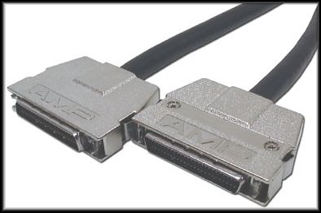
Serial Communication Standards
Three key serial
communication standards:
  HSSI:
    A High-Speed
    Serial Interface
    supports
    transmission rates
    up to 52 Mb/s.
    Engineers use HSSI to connect routers on LANs with WANs over high-speed lines such as T3 lines.

Slide 13
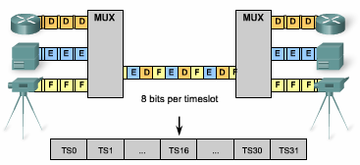
Time Division Multiplexing (TDM)
Bell Laboratories invented TDM to maximize the amount of voice traffic carried over a medium.
Compare TDM to a train with 32 railroad cars.
  Each car is owned by a different freight company, and every day the train leaves with the 32 cars attached.
  If the companies has cargo to send, the car is loaded.
  If the company has nothing to send, the car remains empty but stays on the train.
  Shipping empty containers is not very efficient.
  TDM shares this inefficiency when traffic is intermittent, because the time slot is still allocated even when the channel has no data to transmit.
Notes:
Use graphic 1.1.1.1
Use graphic 1.1.1.3

Slide 14
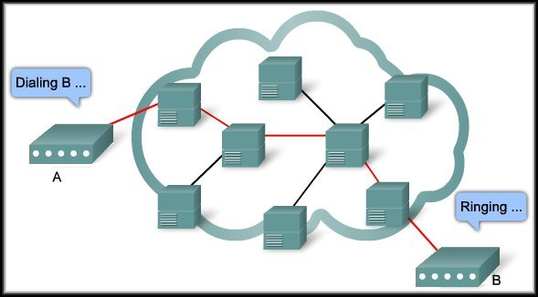
Time Division Multiplexing
Remember that a
WAN connection
normally uses a
provider’s network.
The internal path is
shared by several
conversations or
WAN connections.
Time Division Multiplexing (TDM) is used to give each conversation a share of the connection in turn.
  TDM assures that a fixed capacity connection is made available to the subscriber.

Slide 15
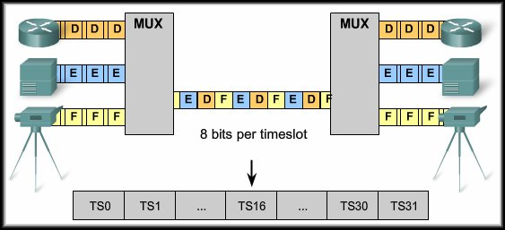
Time Division Multiplexing
Time-Division Multiplexing (TDM) is the transmission of several sources of information using one common channel, or signal, and then the reconstruction of the original streams at the remote end.
  TDM is a physical layer concept.
  It has no regard of the information that is being multiplexed.

Slide 16
Time Division Multiplexing
TDM Operation:
  Each device
  attached to the
  MUX is assigned
  a specific
  time slot.
  8 bits from each time slot are read and are used to build the frame.
  If there is nothing to send from that time slot, it still takes up space in the frame (null characters).
  At the receiving end, the frame is de-capsulated and time slot data is forwarded to the appropriate device.
  A technique called bit interleaving keeps track of the sequence of the bits so that they can be efficiently reassembled into their original form.

Slide 17
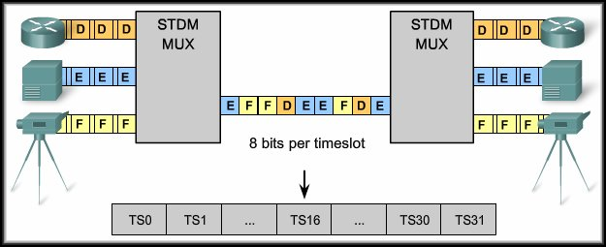
Statistical Time Division Multiplexing
Remember that TDM
will fill an empty time
slot with null
characters if there is
no data.
Inefficient.
  Statistical Time Division Multiplexing (STDM) was developed to overcome this inefficiency.
    It uses a variable time slot length allowing channels to compete for any free slot space.
    It employs buffer memory to temporarily store the data and requires each transmission to carry identification information (a channel identifier).

Slide 18
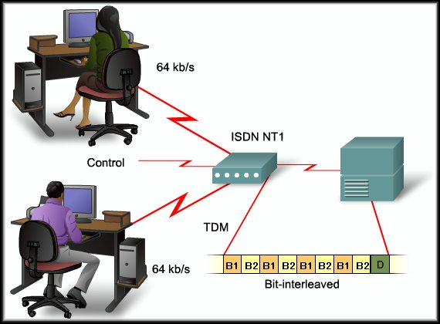
TDM and STDM Examples
Integrated Services Digital Network (ISDN)…..TDM
10 time slots

Slide 19
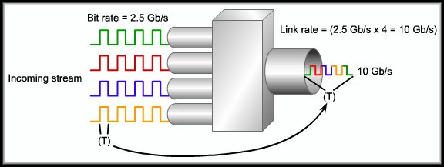
TDM and STDM Examples
Synchronous Optical Networking (SONET – North Amer)
Synchronous Digital Hierarchy (SDH – elsewhere)
Output as a single stream on fiber.
Bit rate = 4 x n
Multiple (n)
input channels.
Optically multiplexed and modulated to 4 times the input bit rate.

Slide 20
TDM and STDM Examples
T-carrier Hierarchy:
  The original unit used in multiplexing telephone calls is 64 kb/s, which represents one phone call.
  It is referred to as a DS-0 or DS0 (digital signal level zero).
  T1:
    In North America, 24 DS0 units are multiplexed using TDM into a higher bit-rate signal with an aggregate speed of 1.544 Mb/s for transmission over T1 lines.
  E1:
    Outside North America, 32 DS0 units are multiplexed for E1 transmission at 2.048 Mb/s.

Slide 21
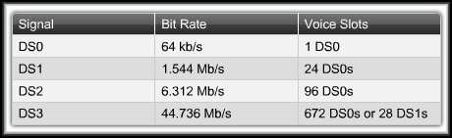
TDM and STDM Examples
T-Carrier Hierarchy:
  While it is common to refer to a 1.544 Mb/s transmission as a T1, it is more correct to refer to it as DS1.
  T-carrier refers to the bundling of DS0s.

Slide 22
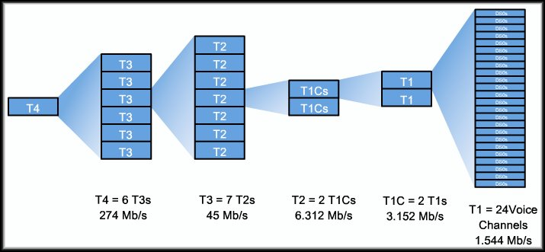
TDM and STDM Examples
T-Carrier Hierarchy:

Slide 23
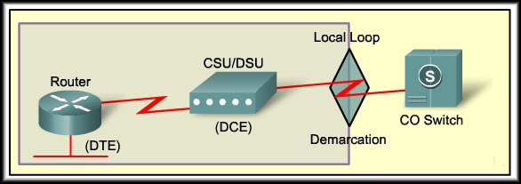
Demarcation Point (Demarc)
Deregulation forced telephone companies to unbundle their local loop infrastructure to allow other suppliers to provide equipment and services.
The demarcation point marks the point where your network interfaces with the network owned by another organization.
Subscriber owned and maintained.
Provider
This YOUR responsibility, including the wiring.

Slide 24
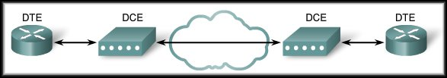
DTE and DCE
DTE: Data Terminal Equipment
  Router, Terminal, PC, Printer, Fax Machine
DCE: Data Communications Equipment
  CSU/DSU, Modem (Internal or External)
A serial connection has a DTE device at one end of the connection and a DCE device at the other end.
The connection between the two DCE devices is the WAN service provider transmission network.

Slide 25
DTE and DCE
DCE and DTE Cable Standards:
  Originally, the concept of DCEs and DTEs was based on two types of equipment:
    Terminal equipment that generated or received data.
    Communication equipment that only relayed data.
  While the reasons are no longer significant, we are left with two different types of cables:
    One for connecting a DTE to a DCE.
    Another for connecting two DTEs directly to each other.

Slide 26
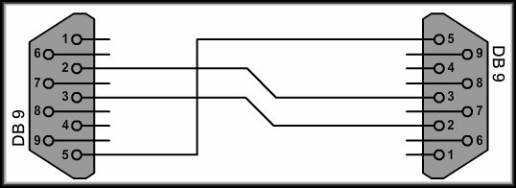
DTE and DCE
DCE and DTE Cable Standards:
  RS232 Standard:
    The original RS-232 standard only defined the connection of DTEs with DCEs (modems).
    If you want to connect two DTEs, such as two computers or two routers in the lab, a special cable called a null modem eliminates the need for a DCE.

Slide 27
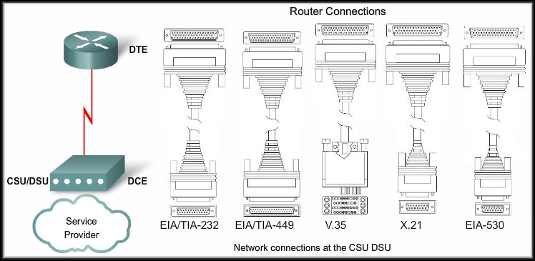
DTE and DCE
DCE and DTE Cable Standards:

Slide 28
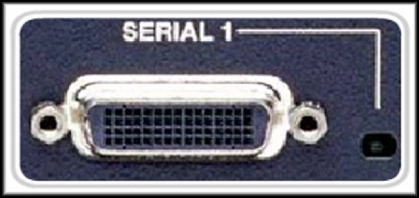
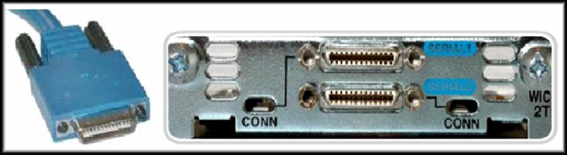
DTE and DCE
DCE and DTE Cable Standards:
Router DB-60 Connection
Router Smart Serial

Slide 29
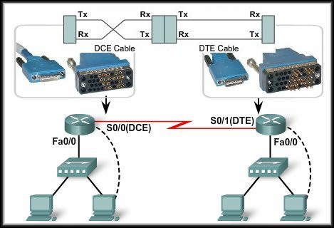
DTE and DCE
DCE and DTE Cable Standards:
  In the lab:

Slide 30
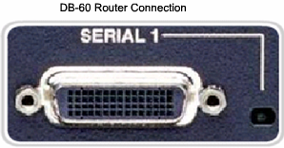
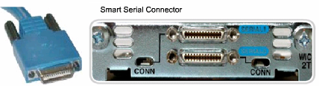
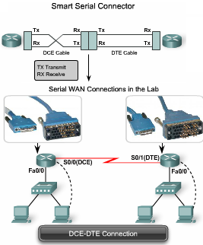
DTE and DCE
The DB-60 Connector
  The cable for the DTE to DCE connection is a shielded serial cable. The router end of the serial cable may be a DB-60 connector.
    The other end of the serial transition cable is available with the connector appropriate for the standard that is to be used.
The Smart Serial Connector
  To support higher port densities in a smaller form factor, Cisco has introduced a Smart Serial cable.
    The router interface end of the Smart Serial cable is a 26-pin connector that is significantly more compact than the DB-60 connector.
The Router-to-Router
  When using a null modem, keep in mind that synchronous connections require a clock signal.
  When using a null modem cable in a router-to-router connection, one of the serial interfaces must be configured as the DCE end to provide the clock signal for the connection.
Notes:
Use graphic 1.1.1.1
Use graphic 1.1.1.3

Slide 31
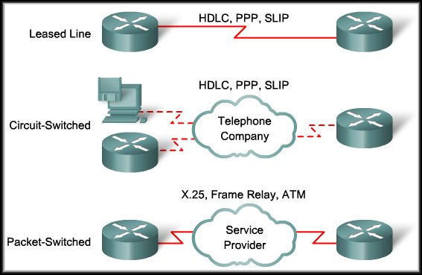
HDLC Encapsulation
Layer 2 WAN Encapsulation Protocols:

Slide 32
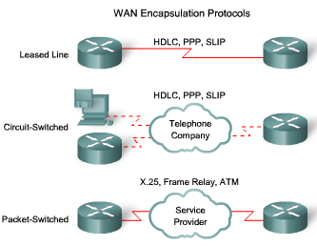
WAN Encapsulation Protocols
On WAN connection, data is encapsulated into frames before crossing the WAN link. The protocol depends on the WAN technology and communicating equipment:
  HDLC - The default encapsulation type on point-to-point connections, when the link uses two Cisco devices.
  PPP - Provides router-to-router and host-to-network connections over synchronous and asynchronous circuits.
    PPP works with several network protocols, such as IP and IPX. PPP also has built-in security mechanisms such as PAP and CHAP.
  Serial Line Internet Protocol (SLIP) - A standard protocol for point-to-point serial connections using TCP/IP.
    SLIP has been largely displaced by PPP.
  X.25/Link Access Procedure, Balanced (LAPB) - X.25 specifies LAPB, a data link layer protocol.
    X.25 is a predecessor to Frame Relay.
  Frame Relay - Frame Relay eliminates some of the time-consuming processes (such as error correction and flow control) employed in X.25.
  ATM - The cell relay in which devices send multiple service types (voice, video, or data) in fixed-length (53-byte) cells.
    Fixed-length cells allow processing to occur in hardware, thereby reducing transit delays.
With SLIP, you have to know the IP address assigned to you by your service provider. You also need to know the IP address of the remote system you will be dialing into. You may also need to configure such details as MTU (maximum transmission unit), MRU (maximum receive unit), etc.
Notes:
Use graphic 1.1.1.1
Use graphic 1.1.1.3

Slide 33
HDLC Encapsulation
High-level Data Link Control (HDLC):
  HDLC is a bit-oriented, synchronous, Data Link layer protocol developed by the International Organization for Standardization (ISO).
    Developed from IBM’s Synchronous Data Link Control (SDLC) standard proposed in the 1970s.
    Provides both connection-oriented and connectionless service.
    Defines a Layer 2 framing structure that allows for flow control and error control through the use of acknowledgments.
    Uses a frame delimiter, or flag, to mark the beginning and the end of each frame.

Slide 34
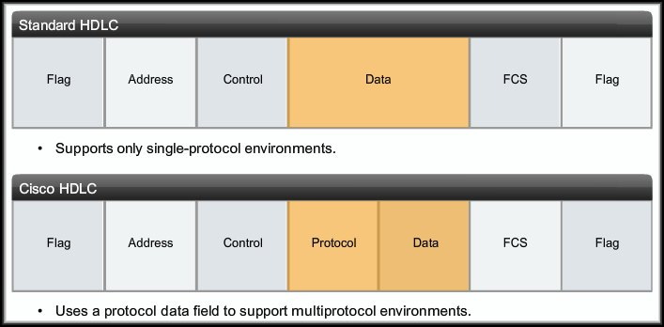
HDLC Encapsulation
High-level Data Link Control (HDLC):
  Cisco has developed an extension to the HLDC protocol to solve an inability to provide multiprotocol support.
    Cisco HLDC is proprietary and is the default encapsulation on a Cisco device WAN port.
    Cisco HDLC frames contain a field for identifying the network protocol being encapsulated.

Slide 35
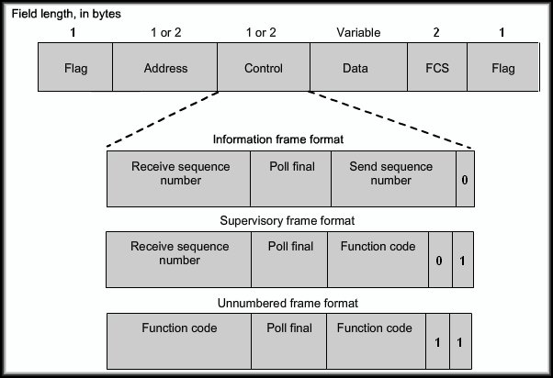
HDLC Encapsulation
Standard/Cisco HDLC Frame Types:
Three frame types but not important to know contents.

Slide 36
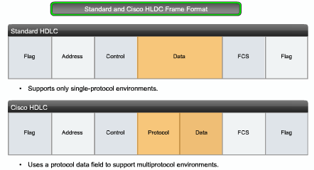
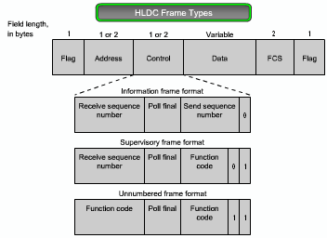
HLDC Frame Types
Flag - The flag field initiates and terminates error checking.
  The frame always starts and ends with an 8-bit flag field. The bit pattern is 01111110.
Address - The address field contains the HDLC address of the secondary station.
  This address can contain a specific address, a group address, or a broadcast address.
Control - HDLC defines three types of frames, each with a different control field format:
  Information (I) frame: I-frames carry upper layer information and some control information.
  Supervisory (S) frame: S-frames provide control information.
  Unnumbered (U) frame: U-frames support control purposes and are not sequenced.
Protocol - (only in Cisco HDLC) It specifies the protocol type encapsulated within the frame (e.g. 0x0800 for IP).
Data - The data field contains a path information unit (PIU) or exchange identification (XID) information.
Frame check sequence (FCS) - The FCS precedes the ending flag delimiter and is usually a cyclic redundancy check (CRC) calculation remainder.
Notes:
Use graphic 1.1.1.1
Use graphic 1.1.1.3

Slide 37
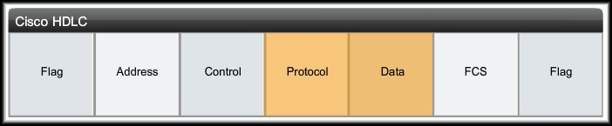
HDLC Encapsulation
HDLC Frame Fields:
Flag:
  The flag field initiates and terminates error checking.
  The frame always starts and ends with an 8-bit flag field.
  The bit pattern is 01111110.
  If the pattern occurs in the data after the flag, zero-bit insertion is used to ensure data integrity.
    ‘0’ bit is inserted after every occurrence of five ‘1’ bits.
    Sender inserts – receiver removes.

Slide 38
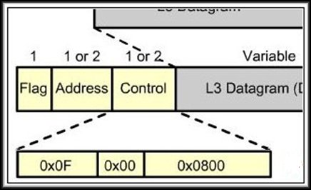
FYI - Cisco Proprietary HDLC Frame - (cHDLC)
  0x0F for Unicast 0x8F for Broadcast packets.
The Control field is always set to zero.
The Protocol Code field is used to specify the protocol type encapsulated within the HDLC frame.

Slide 39
Configuring HDLC Encapsulation
Cisco HDLC is the default encapsulation method used by Cisco devices on synchronous serial lines.
  You use Cisco HDLC as a point-to-point protocol on leased lines between two Cisco devices.
  If you are connecting to a non-Cisco device, use synchronous PPP.
    Router(config)#interface s0/2/0
    Router(config-if)#encapsulation hdlc

Slide 40
FYI - Troubleshooting a Serial interface
For data to move across a serial link, both the interface (Layer 1) and the line protocol (Layer 2) must be in the “up” state.
  Layer 1:
    The Layer 1 physical interface must be up before the logical Layer 2 protocol can come up.
    When the provider’s circuit becomes active, a clocking or carrier detect signal is sent to the CSU/DSU.
    The CSU/DSU recognizes that the line is active and sends the same signal to the DTE device.
    You will see this signal referenced as CD or DCD either on a LED (CSU/DSU or modem) or in a status display (DCD=up).

Slide 41
FYI - Troubleshooting a Serial interface
For data to move across a serial link, both the interface (Layer 1) and the line protocol (Layer 2) must be in the “up” state.
  Layer 2:
    Once the physical link is active, the Layer 2 protocol can begin it’s connection process.
    The Layer 2 connect will depend upon the line protocol in use. (Frame Relay / PPP / X.25)
    Additionally, keepalive packets are sent by the remote router on a regular basis (usually every 10 seconds) to ensure that the link is still usable.
    Once the Layer 2 connection is made, the line protocol is up.

Slide 42
Troubleshooting A Serial Interface
show interfaces serial command:
  Will show the status of all serial links on the router.
  The interface status line has six possible states:
serial x is up, line protocol is up
serial x is down, line protocol is down
serial x is up, line protocol is down
serial x is up, line protocol is up (looped)
serial x is up, line protocol is down (disabled)
serial x is administratively down,
line protocol is down

Slide 43
Troubleshooting A Serial Interface
serial x is up, line protocol is up
  Proper status for the link.

Slide 44
Troubleshooting A Serial Interface
serial x is down, line protocol is down
  The router is not sensing the carrier detect signal.
  Possible Causes:
    Router cable is faulty or incorrect.
    Router has a faulty router interface.
    CSU/DSU hardware failure.
    Provider’s circuit is down or it is not connected to the CSU/DSU.

Slide 45
Troubleshooting A Serial Interface
serial x is up, line protocol is down
  A local or remote router is not reachable.
  Possible Causes:
    Router not receiving/sending keepalive packets.
    Local router has a faulty router interface.
    Local router cable is faulty.
    Local CSU/DSU not providing the DCD signal.
    Local CSU/DSU hardware failure.
    Provider’s circuit is down.
    One of the LOCAL conditions above exist at the remote end of the link.

Slide 46
Troubleshooting A Serial Interface
serial x is up, line protocol is up (looped)
  A loop exists in the circuit.
    The sequence number in the keepalive packet changes to a random number when a loop is detected. If the same number is returned, a loop exists.
  Possible Causes:
    Misconfigured loopback interface.
    CSU/DSU manually set in loopback mode.
    CSU/DSU remotely set in loopback mode by the provider.

Slide 47
Troubleshooting A Serial Interface
serial x is up,
line protocol is down (disabled)
  A high error rate exists.
  Possible Causes:
    A high error rate exists on the provider’s circuit due to a provider problem.
    CSU/DSU hardware problem.
    Router interface hardware problem.

Slide 48
Troubleshooting A Serial Interface
serial x is administratively down,
line protocol is down
  Router configuration problem.
  Possible Causes:
    Duplicate IP Address exists.
    The no shutdown command has not been entered for the serial interface.
P.S. I tried to get Cisco to change the message to
serial x is administratively down,
line protocol is down, DUMBASS
but they said that while they agreed, they couldn’t
possibly make that change…..

